Slide 1
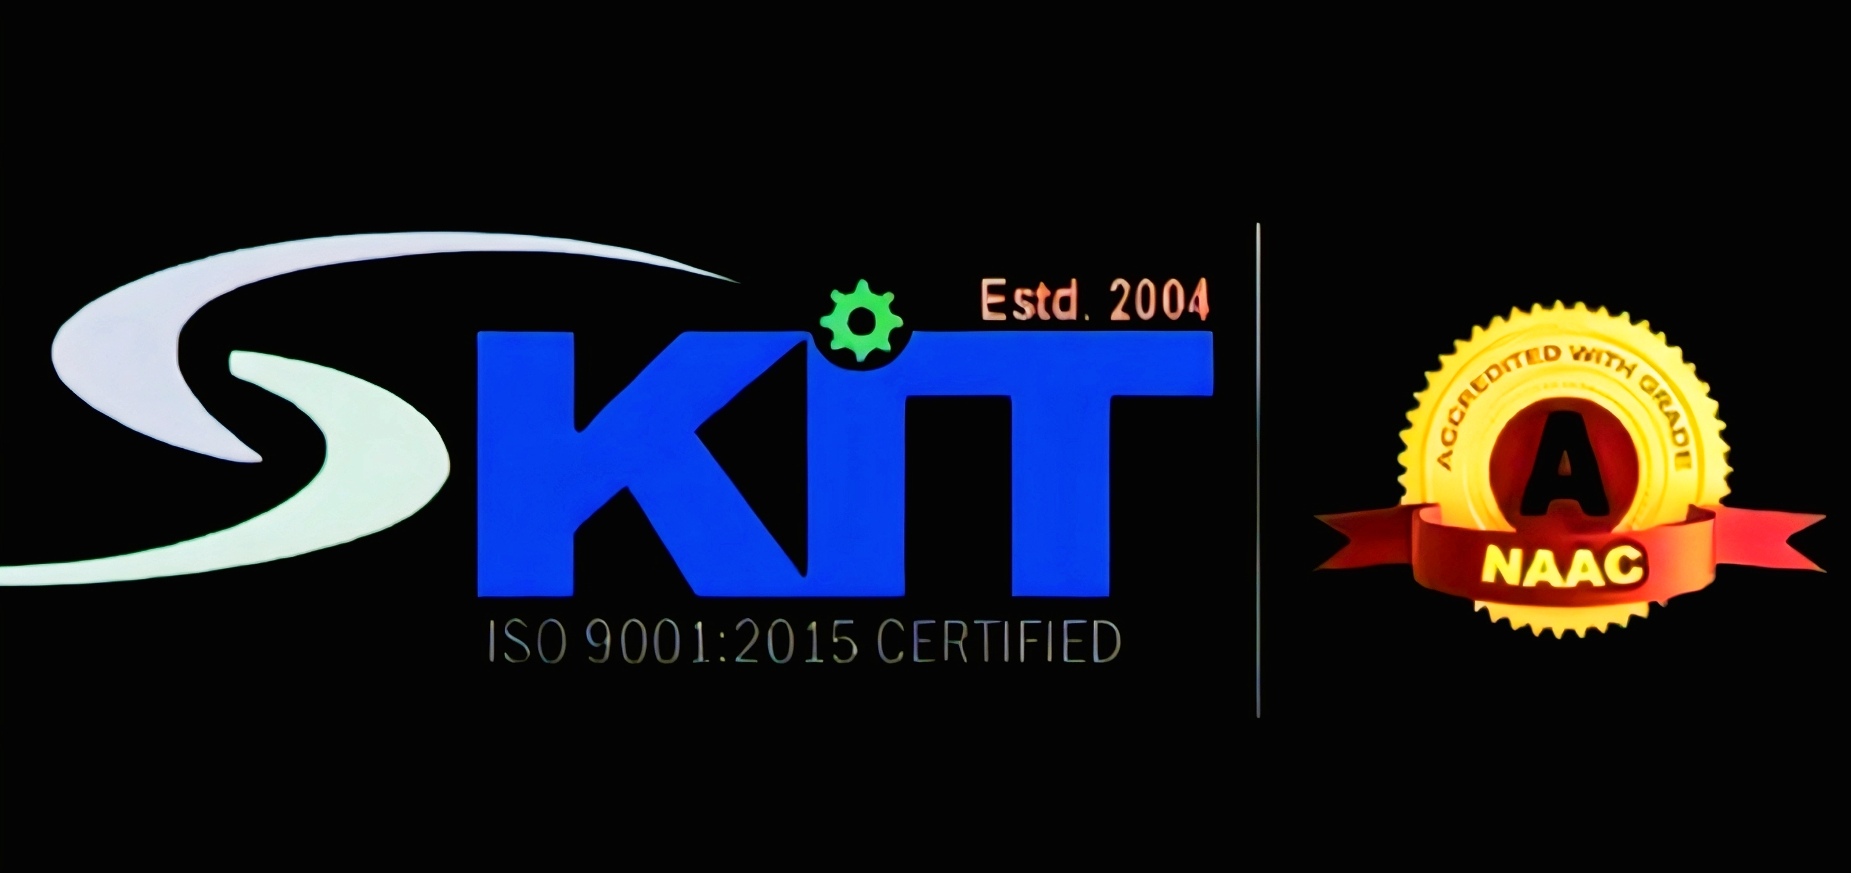
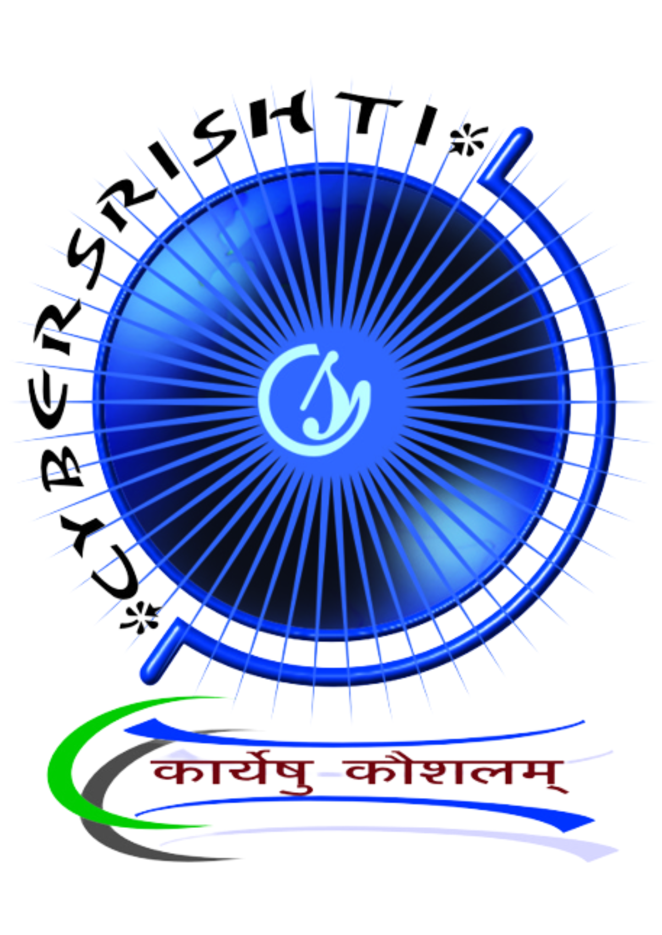
AVIOTHIC 2.O
NOVEXA
Team leader : Ritika Verma
Team members :
Isha Yadav
Anwesha Shukla
Vanshika Shukla

Slide 2
Description of the problem
Description of the Problem:
Focus on Theory: Today's students are primarily seeking theory or syllabus-based knowledge designed for scoring marks in school, college, or competitive exams.
Lack of Practical Application Teaching: Students are not taught how learned knowledge applies in the real world.
Limited Critical Thinking and Problem-Solving Skills: Due to this, students lack critical thinking and problem-solving skills.
Exam-Focused Online Content: Most learning content available on the internet, YouTube, and Google is focused on exams or trending topics rather than real-life problem-solving.

Slide 3
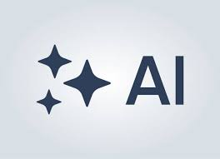
THE PROBLEM
1. What is the problem?
Students mainly learn theoretical or syllabus-based knowledge designed for exams rather than real-world use. Because of this, they don’t know how to apply what they learn in practical situations.
2. Who has this problem?
This problem affects: School and college students (especially in technical or professional courses).Teachers/institutions who want students to gain practical skills. Employers who struggle to find graduates with real-world problem-solving skills.
3. Why should this problem be solved?
Because this gap:
Reduces students’ employability and confidence. Slows down innovation and critical thinking. Makes learning rote-based instead of skill-based. Solving it will help create industry-ready, practically skilled individuals.
4. How will I know this problem has been solved?
You’ll know it’s solved when:
Students can build real-life projects or solve real problems using their theoretical knowledge. Learning platforms and schools start focusing on hands-on activities, simulations, and internships. Improvement in job readiness and student engagement is observed.

Slide 4
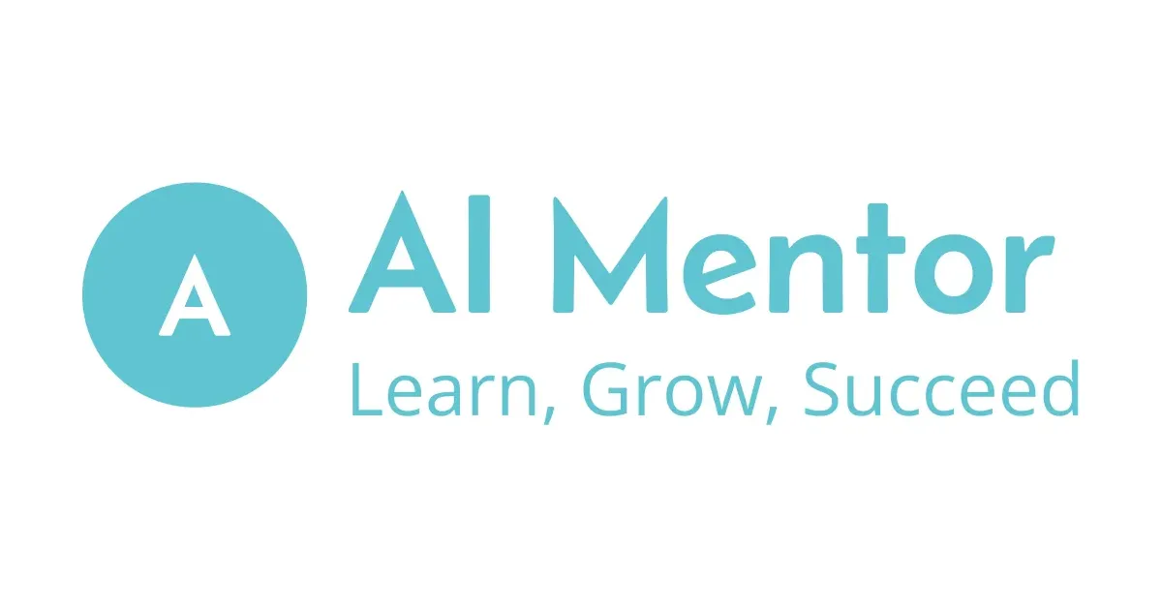
TOOLS USED
Frontend: React / HTML / CSS / JS
Backend: Node.js / Express
Database: MongoDB / JSON
AI: Open API (future integration)
Tools: VS Code, GitHub

Slide 5
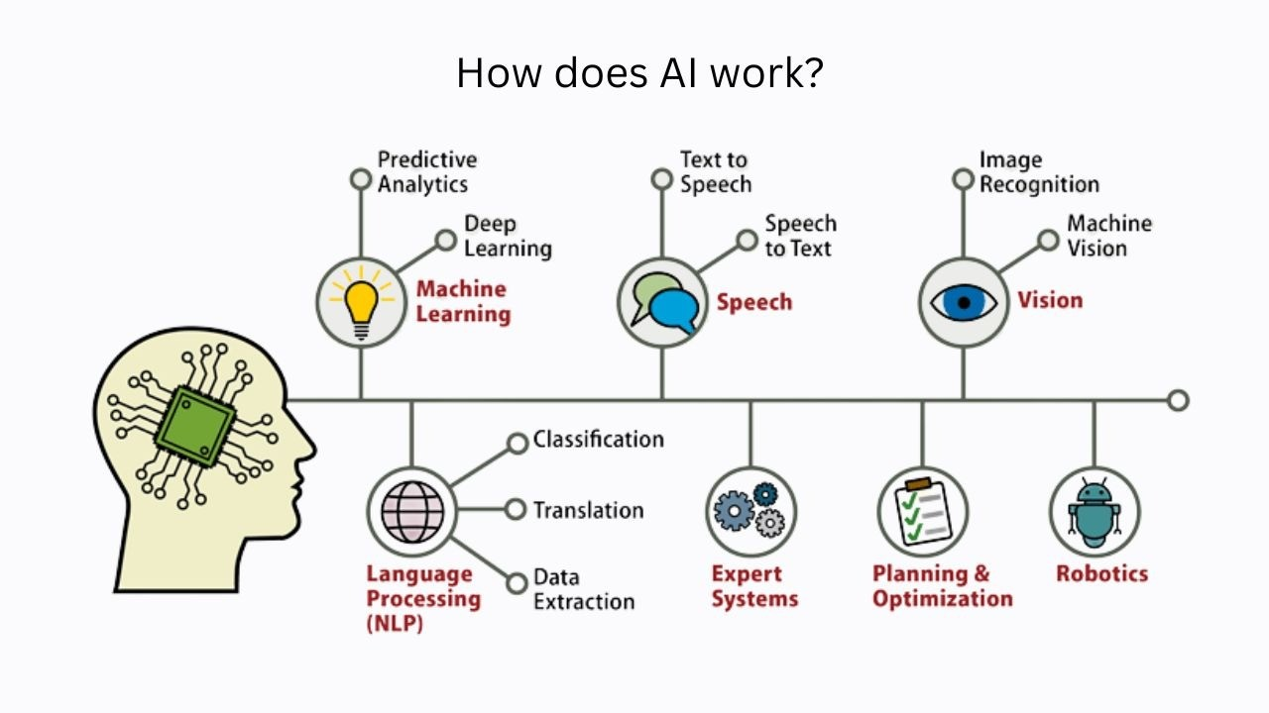
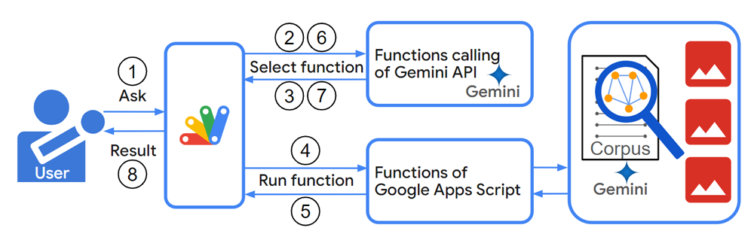
WORKING : how it works

Slide 6


CONCLUSION
The gap between theory and practice remains a major challenge in modern education.
Real learning happens when students can apply concepts in real-life scenarios.
Bridging this gap requires an experiential approach — projects, internships, and hands-on exposure.
Our hackathon project highlights the need for curriculum that balances both theory and application.
Encouraging innovation, critical thinking, and skill-building can make education truly meaningful.

